Slide 1
BRAZOS UNIVERSITY DATA WAREHOUSE
Group No 7
Sairam Janakiraman
BHARADWAJ VENKATESWARAN
RATNADEEP SIMHADRI
DINESH KAKARLA MATHAM

Slide 2


ABOUT THE UNIVERSITY
Founded in 1945 , current enrollment 7000 students
Areas of study liberal arts, music, design and social sciences
Interested in attracting and retaining high-quality students

Slide 3


NEED FOR DATA WAREHOUSE
Increase in Revenue
Maximum utilization of facilities
Better understanding of course enrollment
Tracking admission process
Alumni network

Slide 4
APPROACH
Data marts are created first to provide reporting capability
Each data mart addresses a single business area
The data warehouse can be extended easily to accommodate new business units

Slide 5
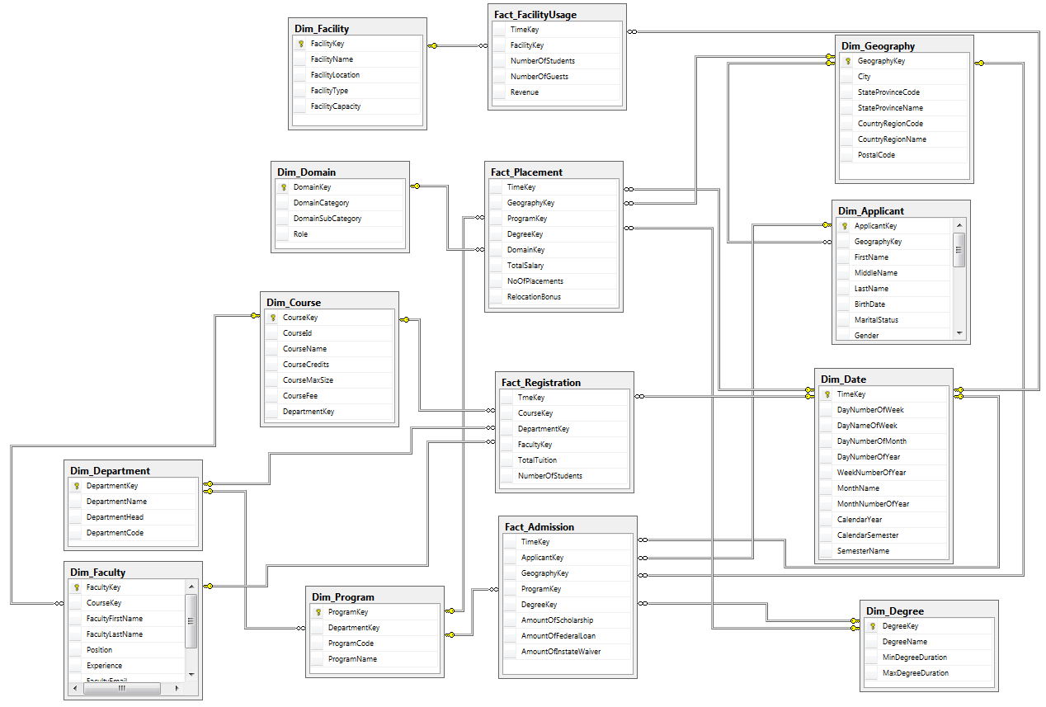
DATAWAREHOUSE SCHEMA

Slide 6
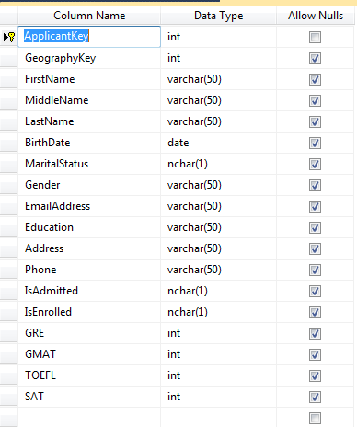
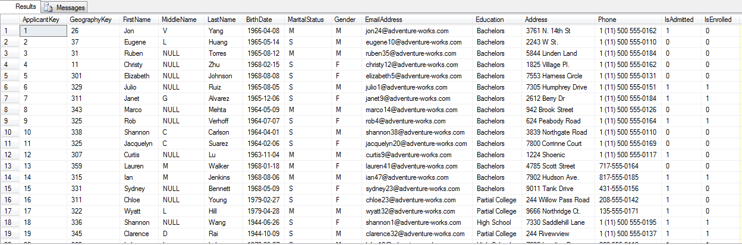
DIMENSION TABLES - APPLICANT

Slide 7
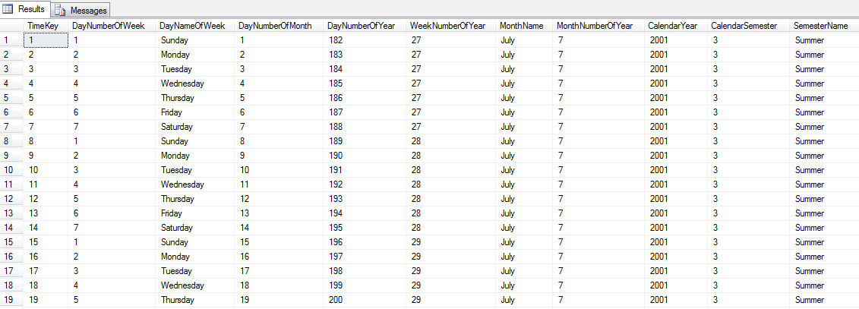
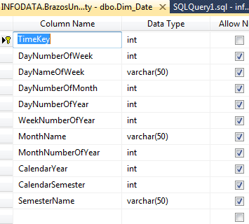
DIMENSION TABLES - DATE

Slide 8
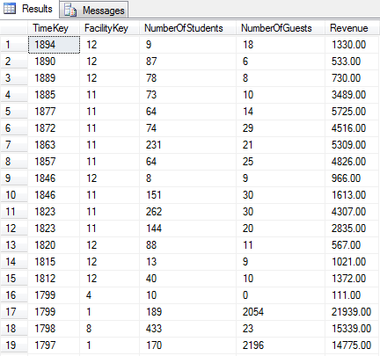
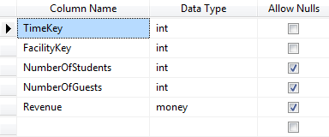
FACT TABLES - FACILITY

Slide 9
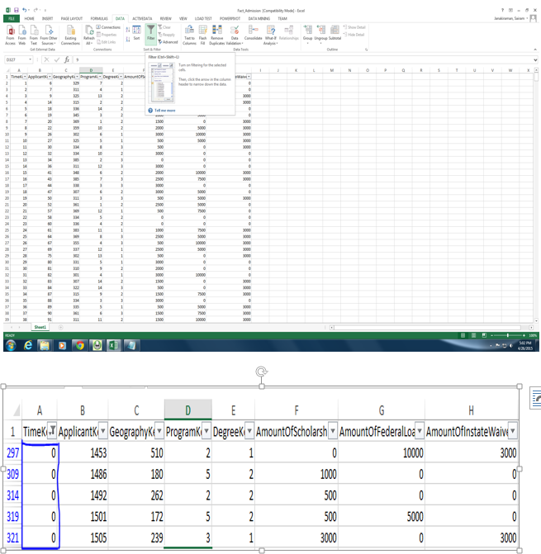
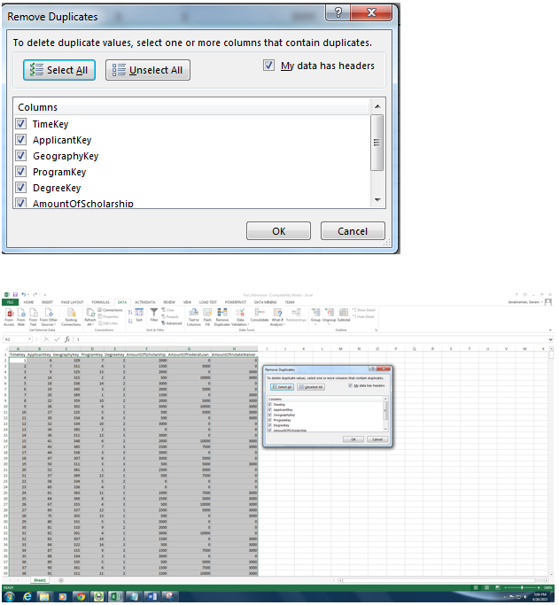
EXTRACTION AND TRANSFORMATION

Slide 10
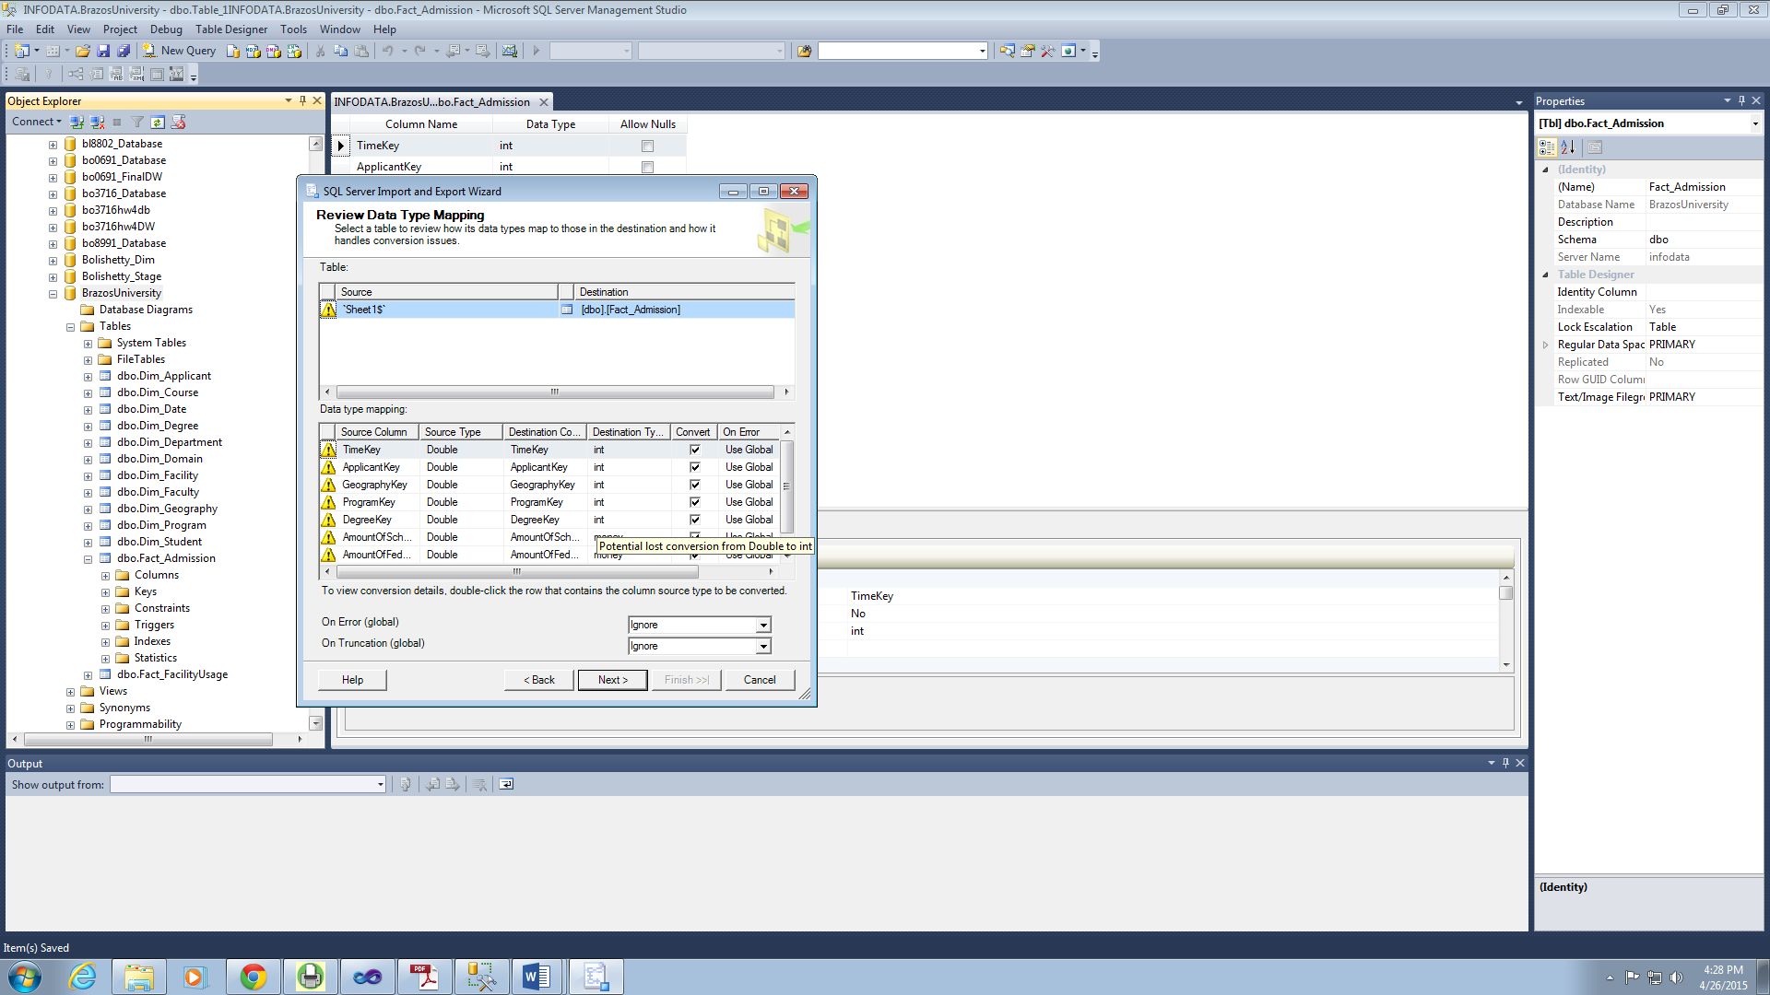
LOADING

Slide 11
ANALYSIS AND REPORTS
Facilities
Admissions and Finance
Course Registration and Revenue
Placements

Slide 12
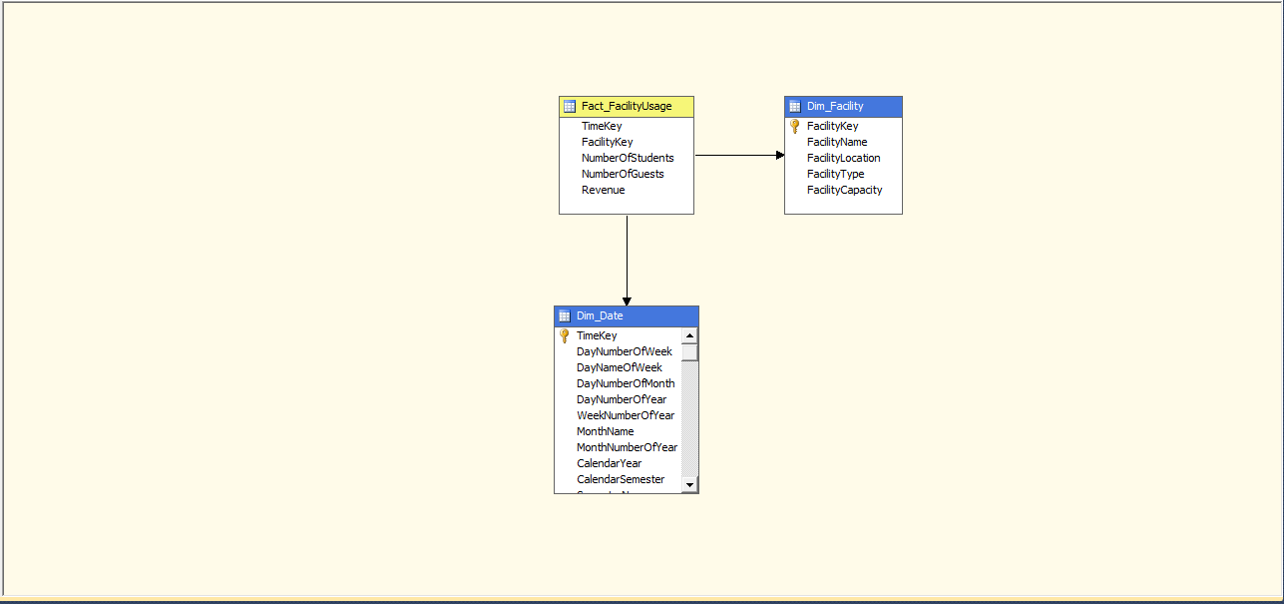
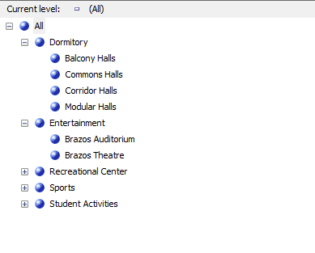
REPORT – FACILITIES

Slide 13
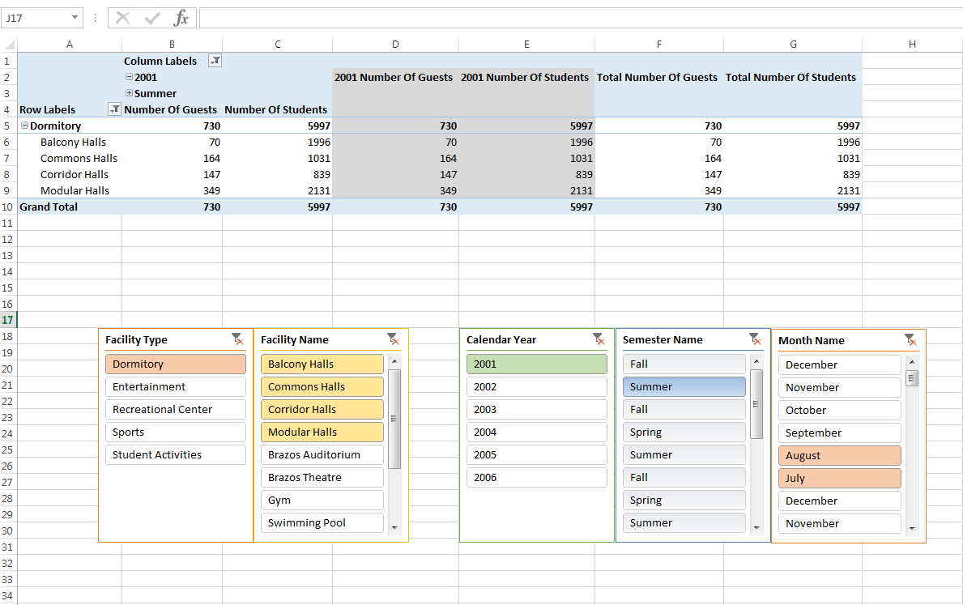
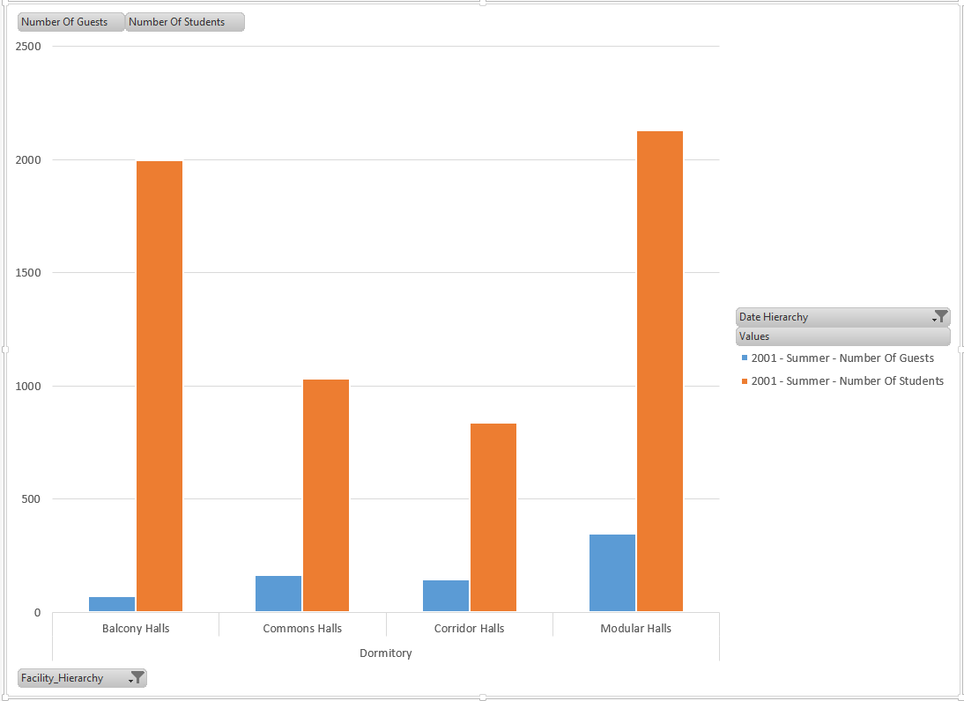
REPORT – FACILITIES

Slide 14
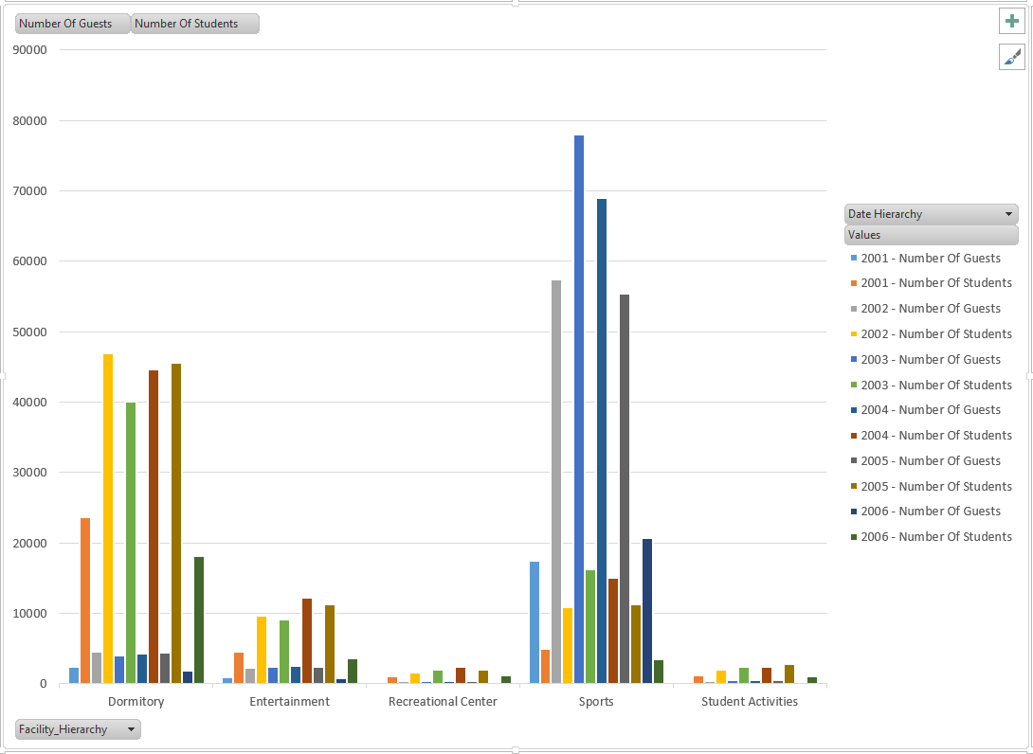
REPORT – FACILITIES

Slide 15
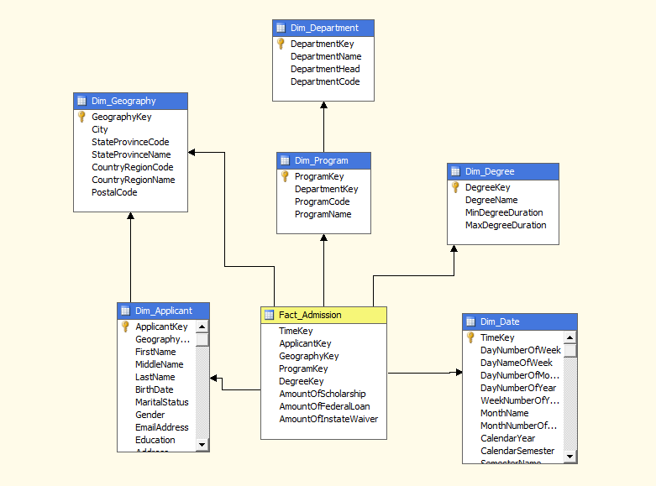
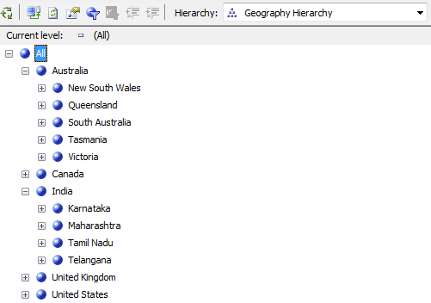
ADMISSIONS AND SCHOLARSHIPS

Slide 16
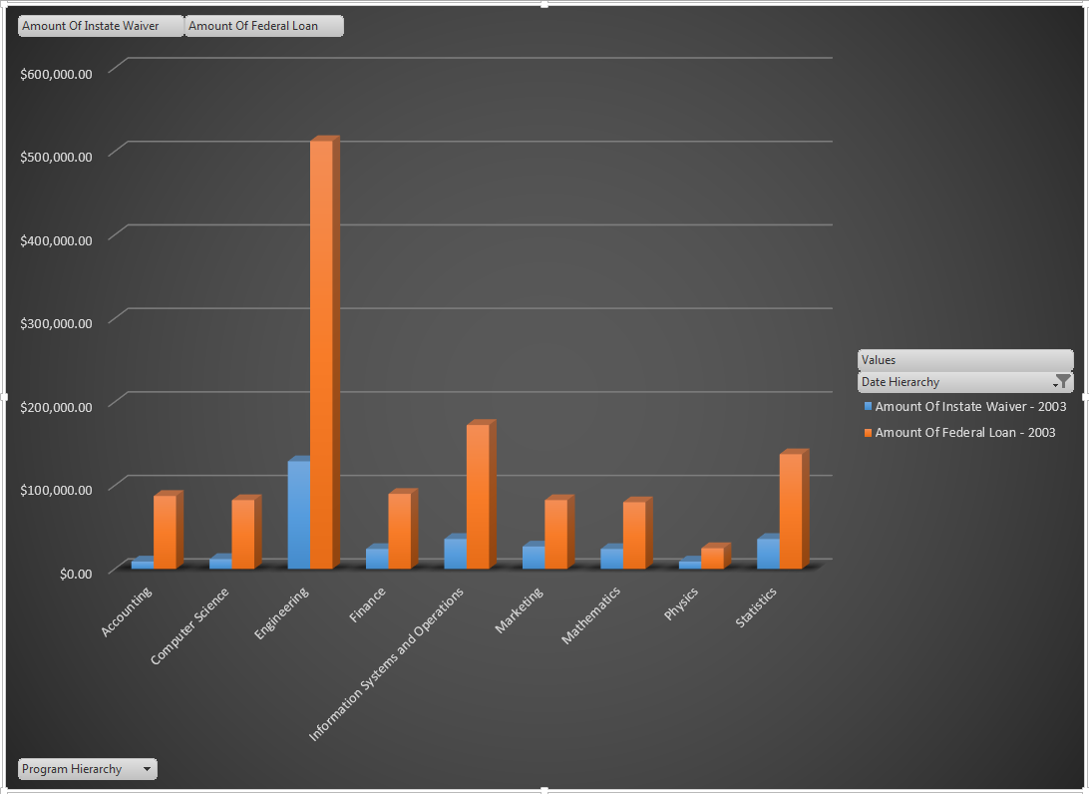
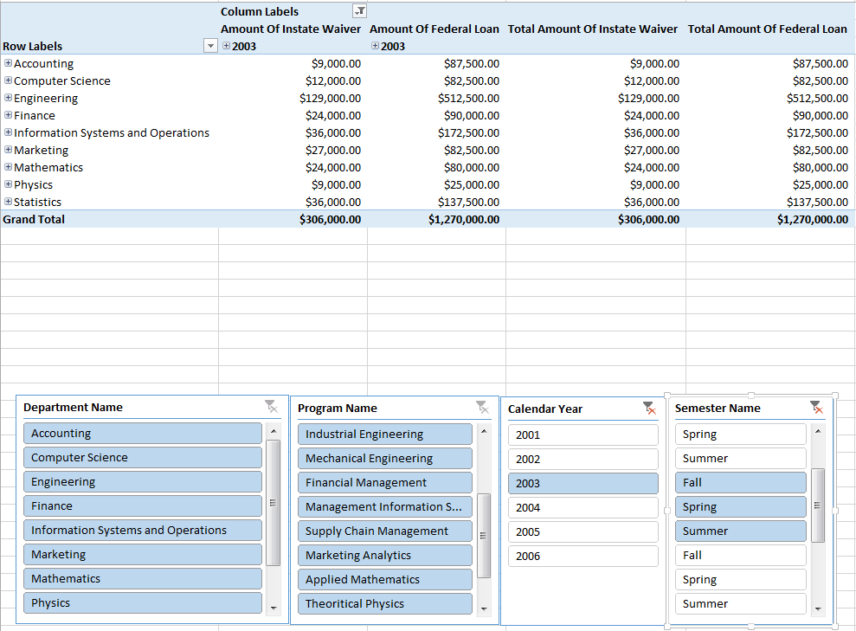
ADMISSIONS AND SCHOLARSHIPS

Slide 17
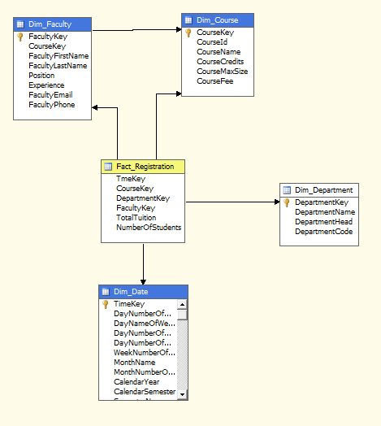
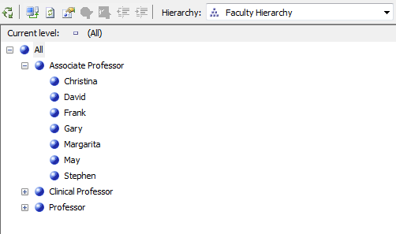
COURSE REGISTRATION AND REVENUE

Slide 18
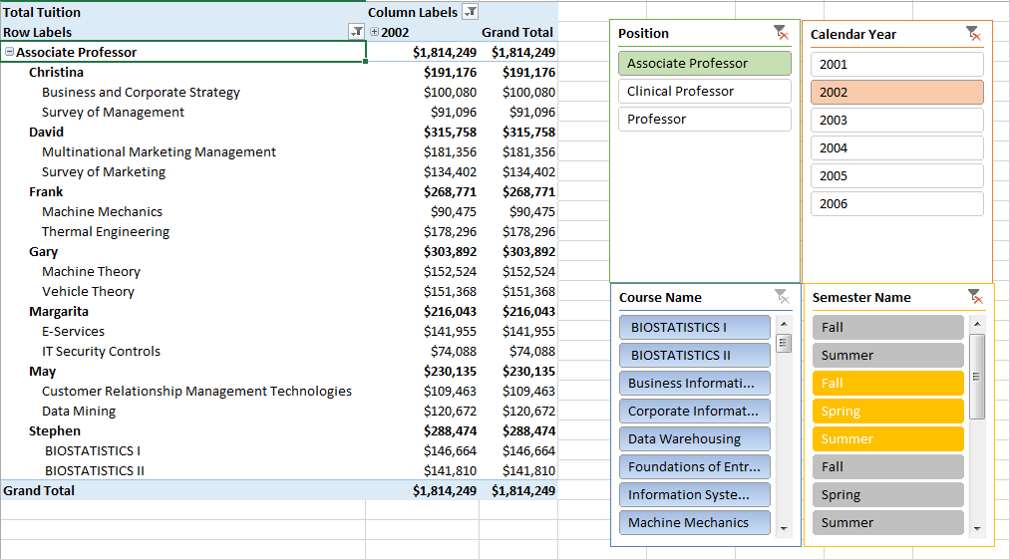
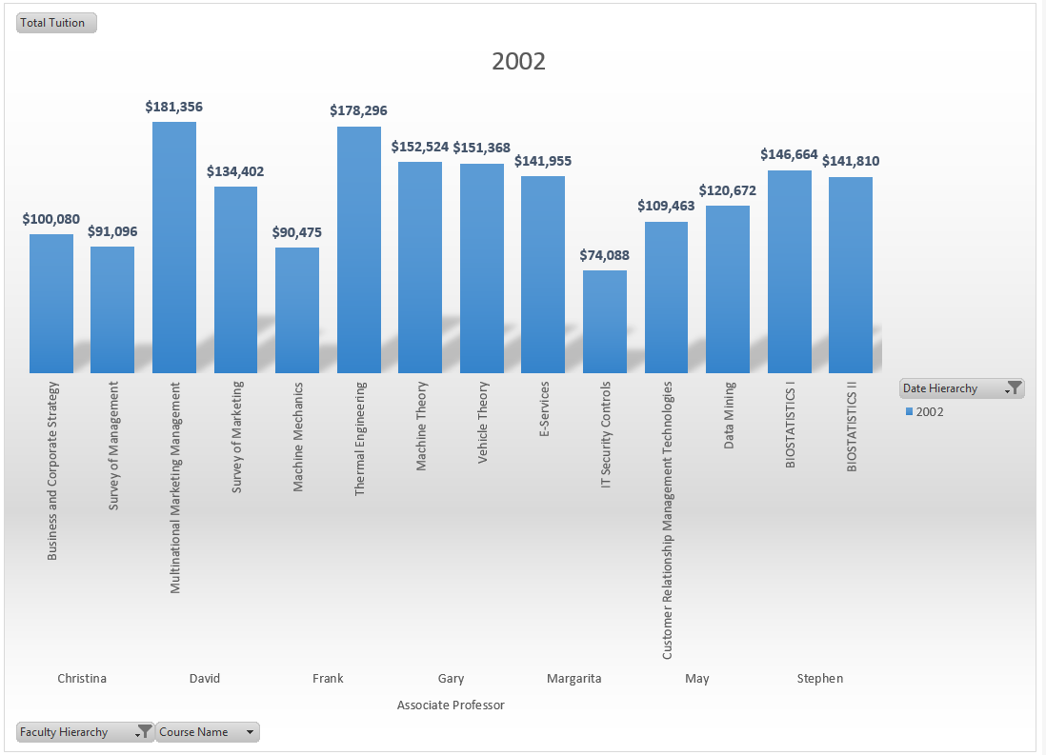
COURSE REGISTRATION AND REVENUE

Slide 19
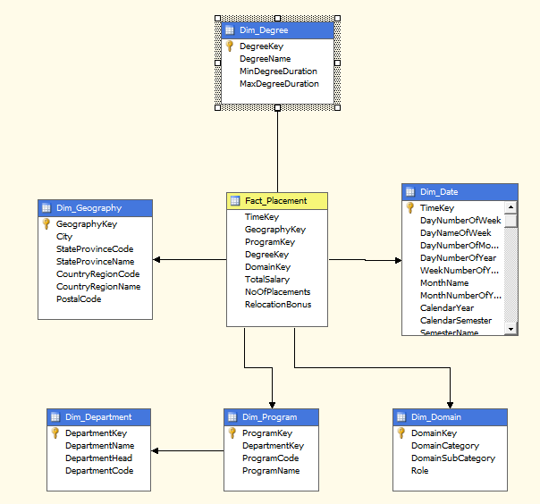
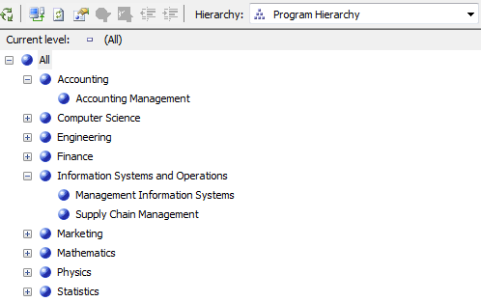
PLACEMENTS

Slide 20
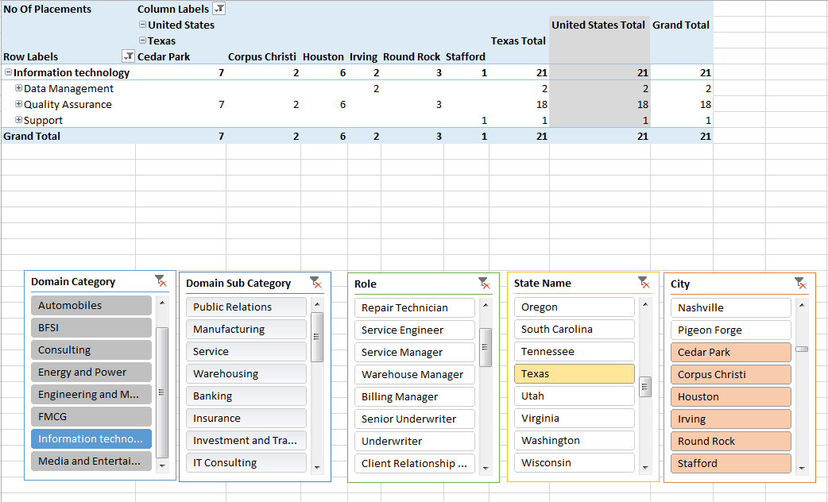
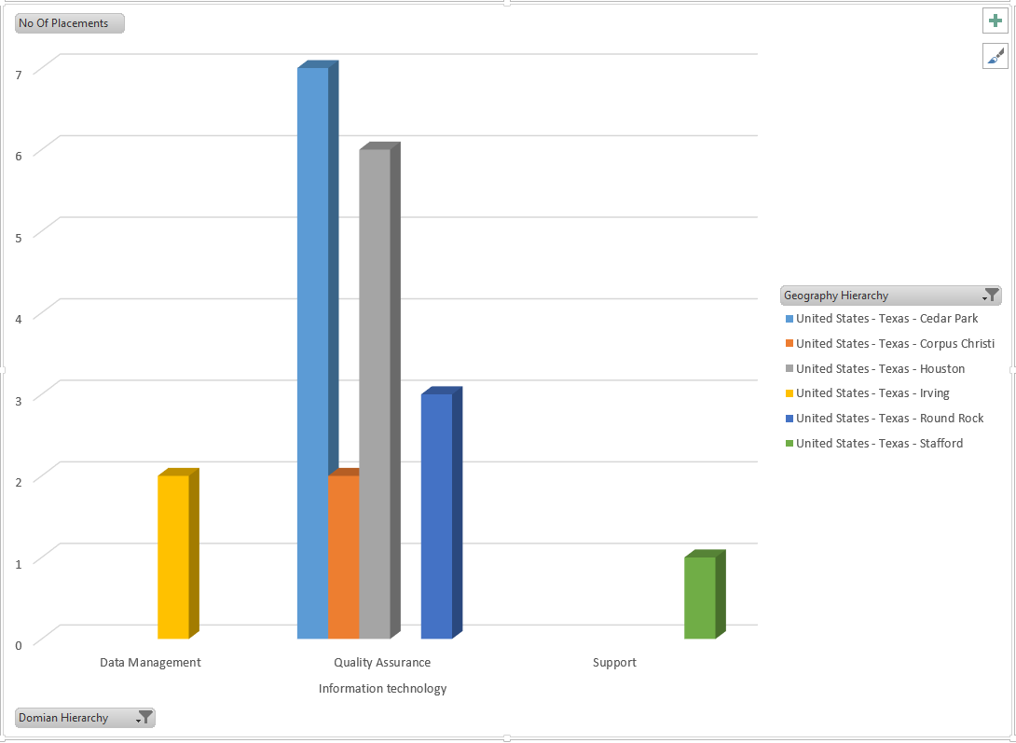
PLACEMENTS

Slide 21
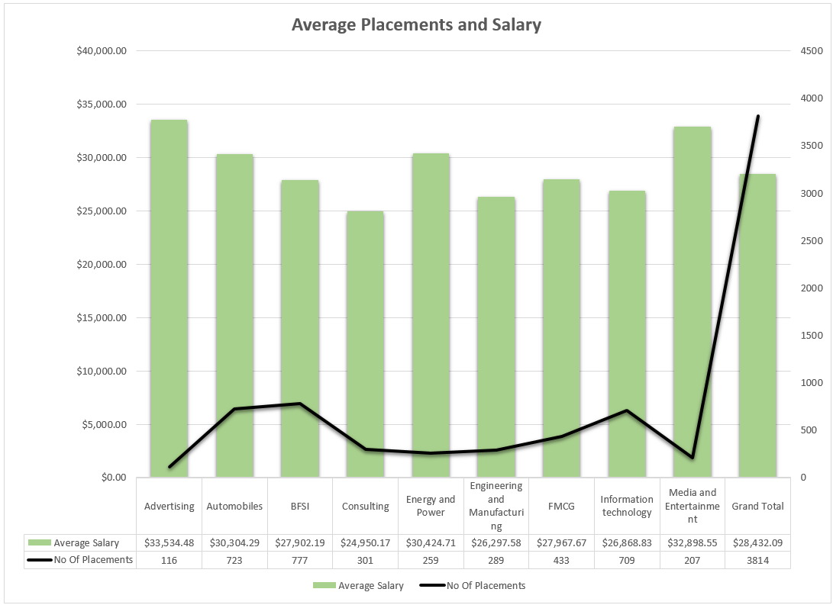
PLACEMENTS

Slide 22


